Slide 1
Colistin population model

Slide 2
Background

Slide 3
Protocol

Slide 4
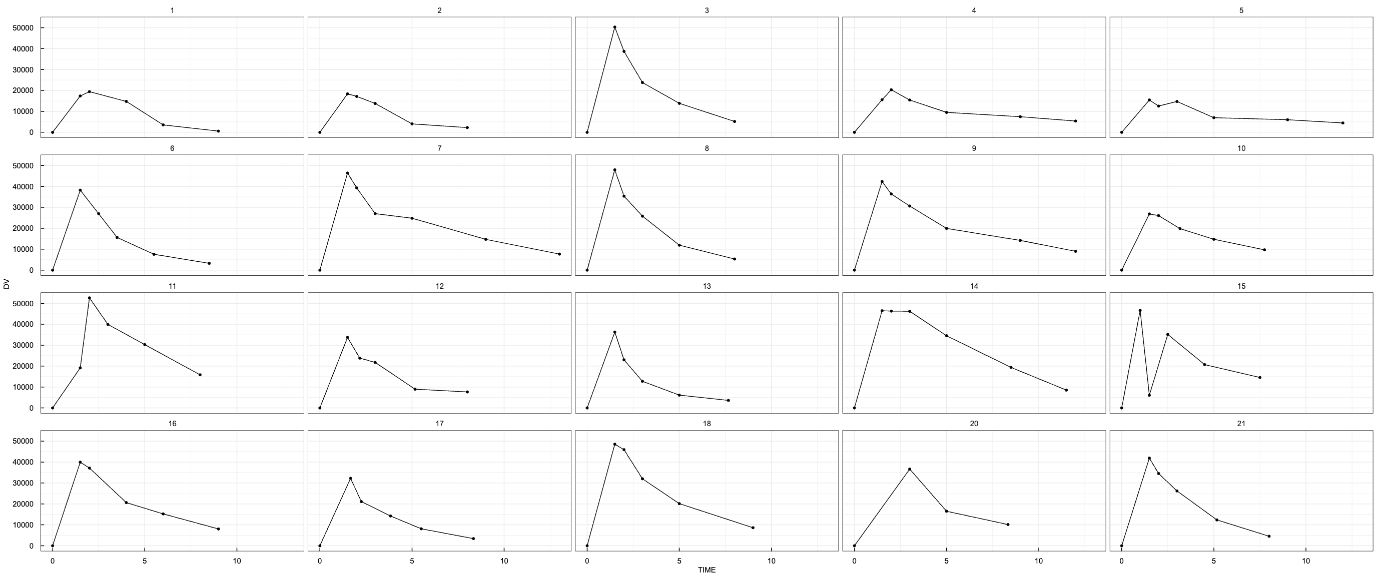
Data exploration (CMS)
Single dose

Slide 5
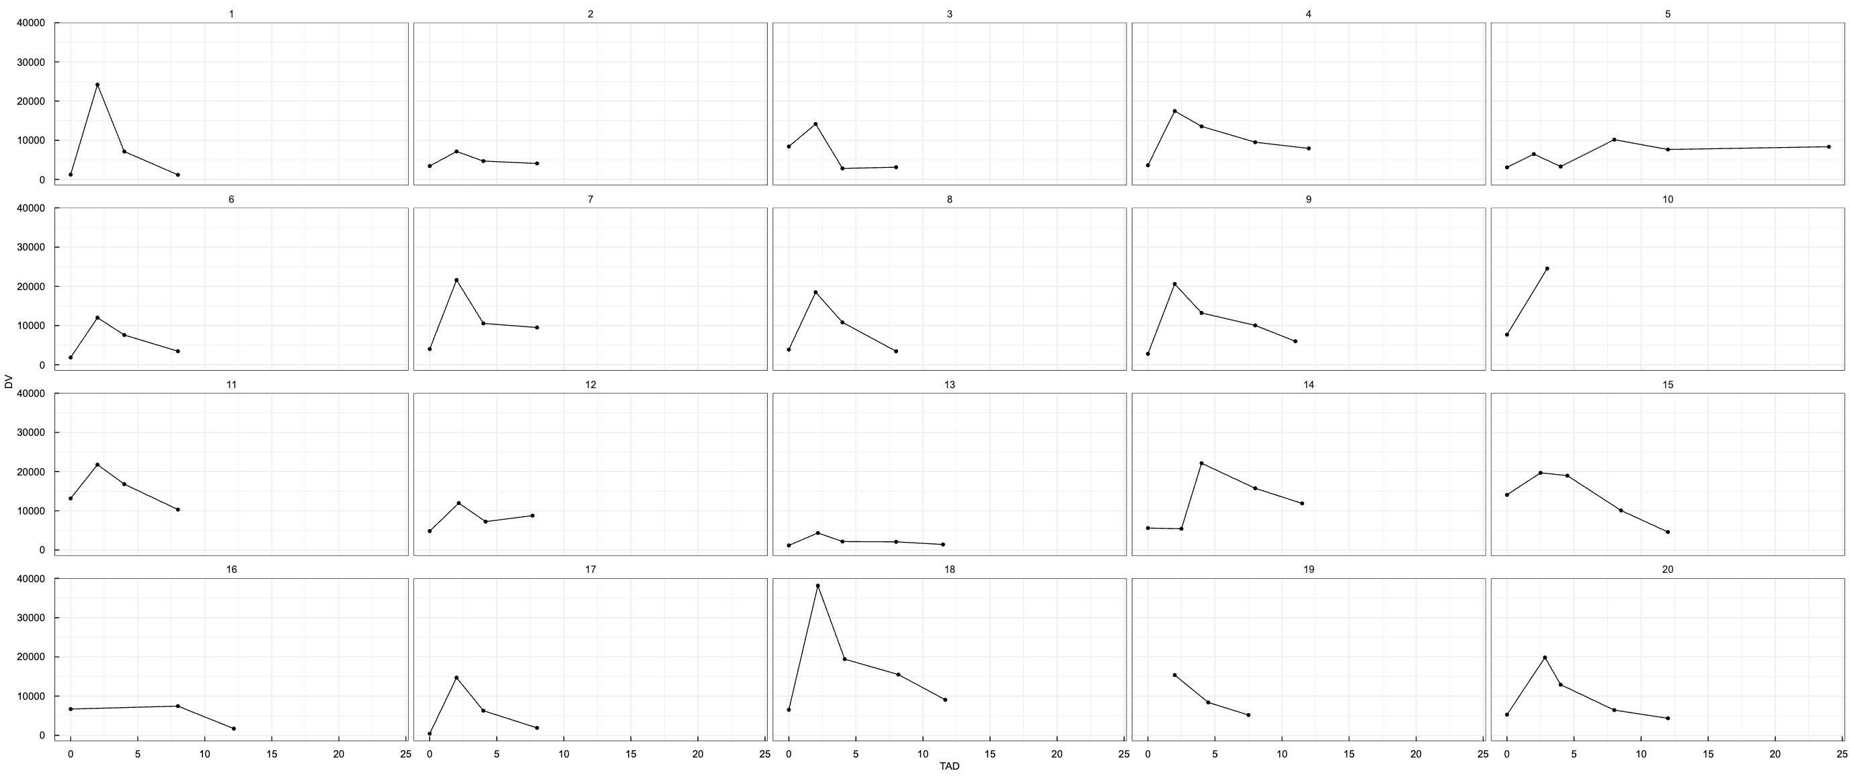
Data exploration (CMS)
Multiple dose

Slide 6
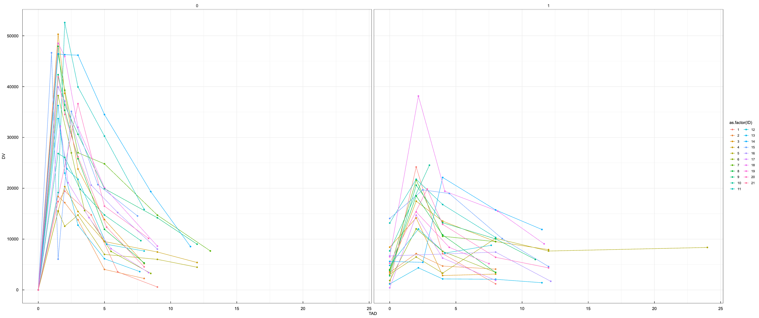
Data exploration (CMS)

Slide 7
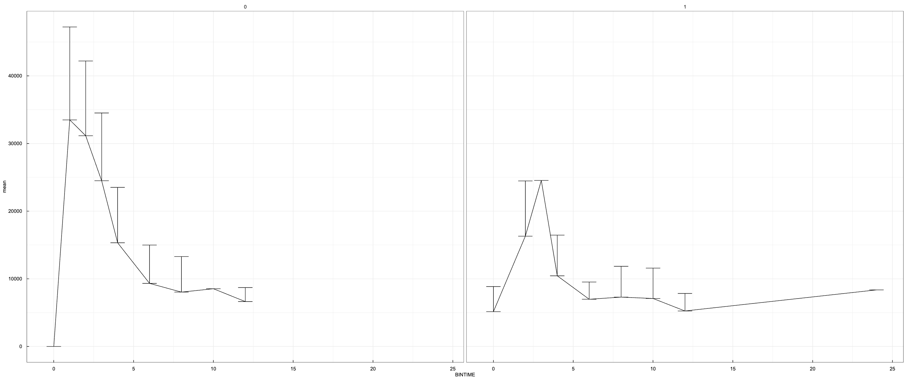
Data exploration (CMS)

Slide 8
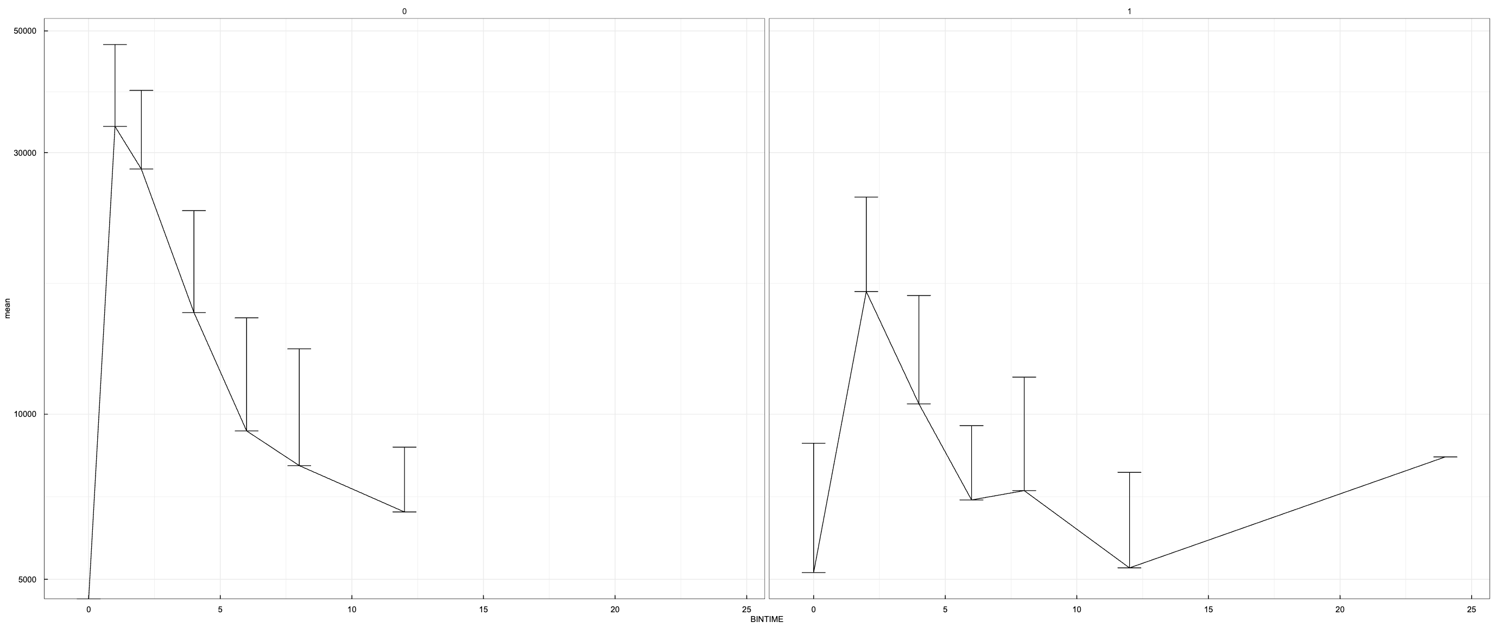
Data exploration (CMS)

Slide 9
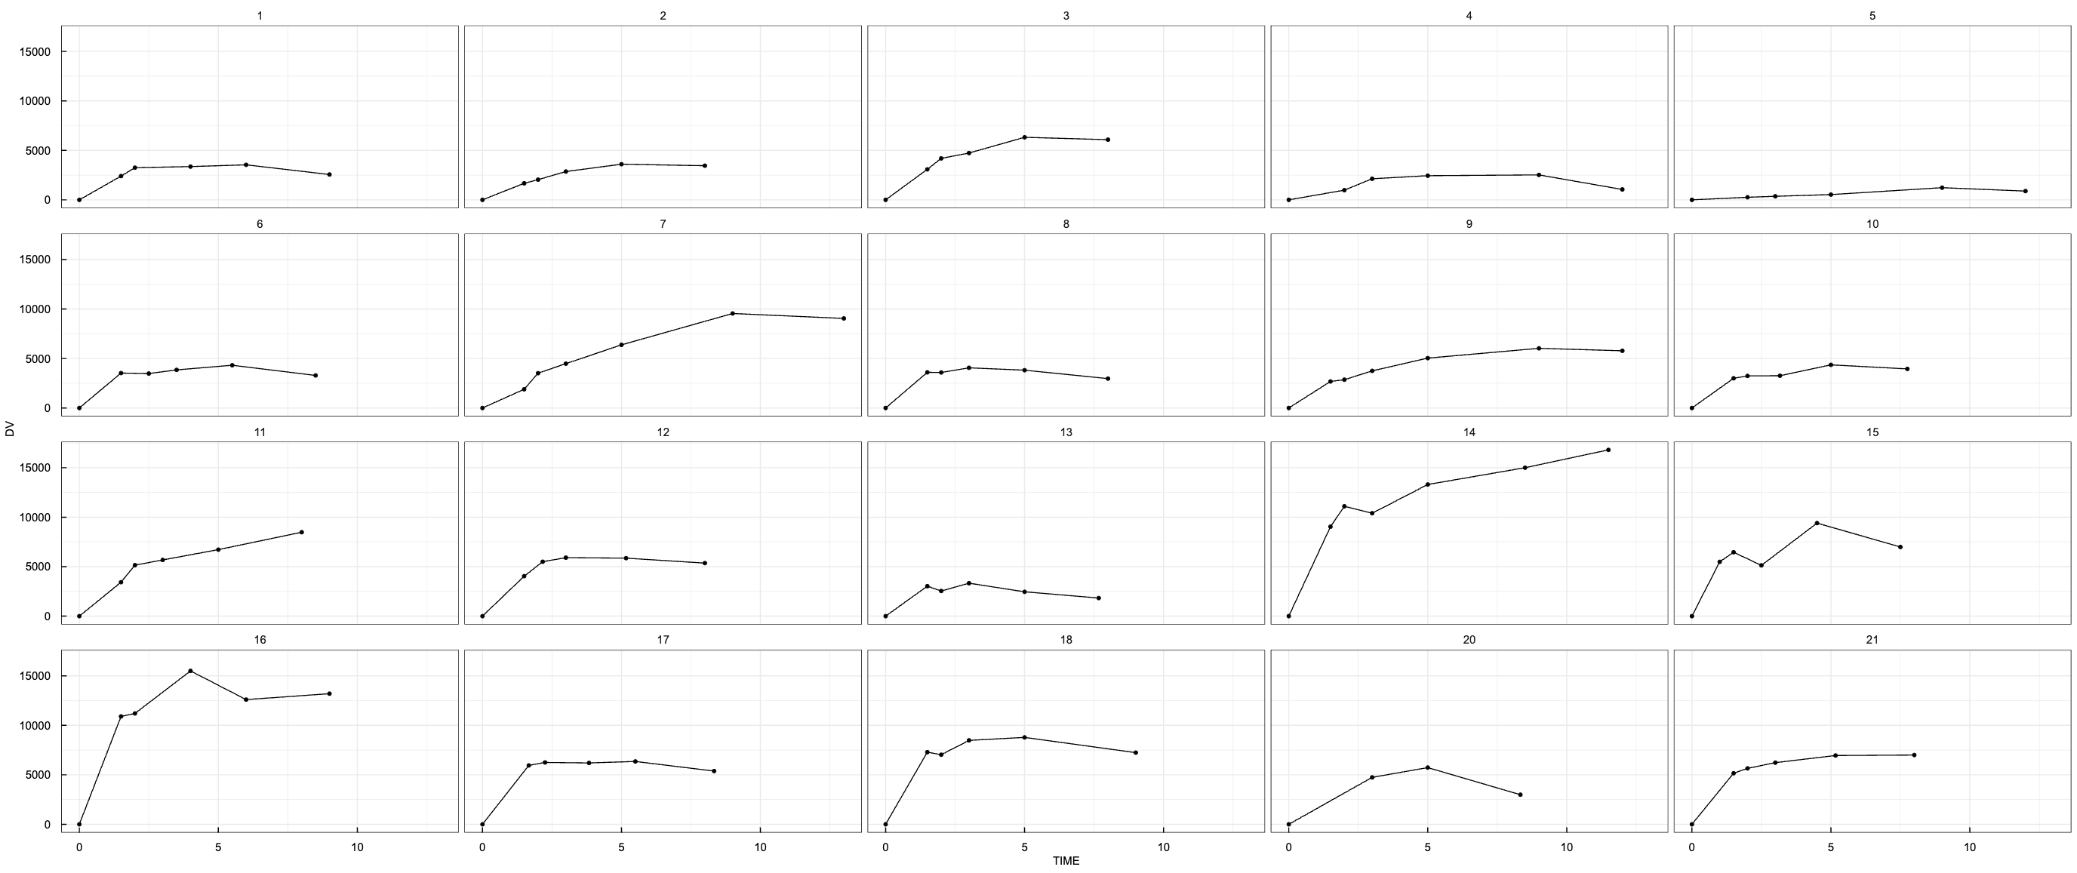
Data exploration (Colistin A)
Single dose

Slide 10
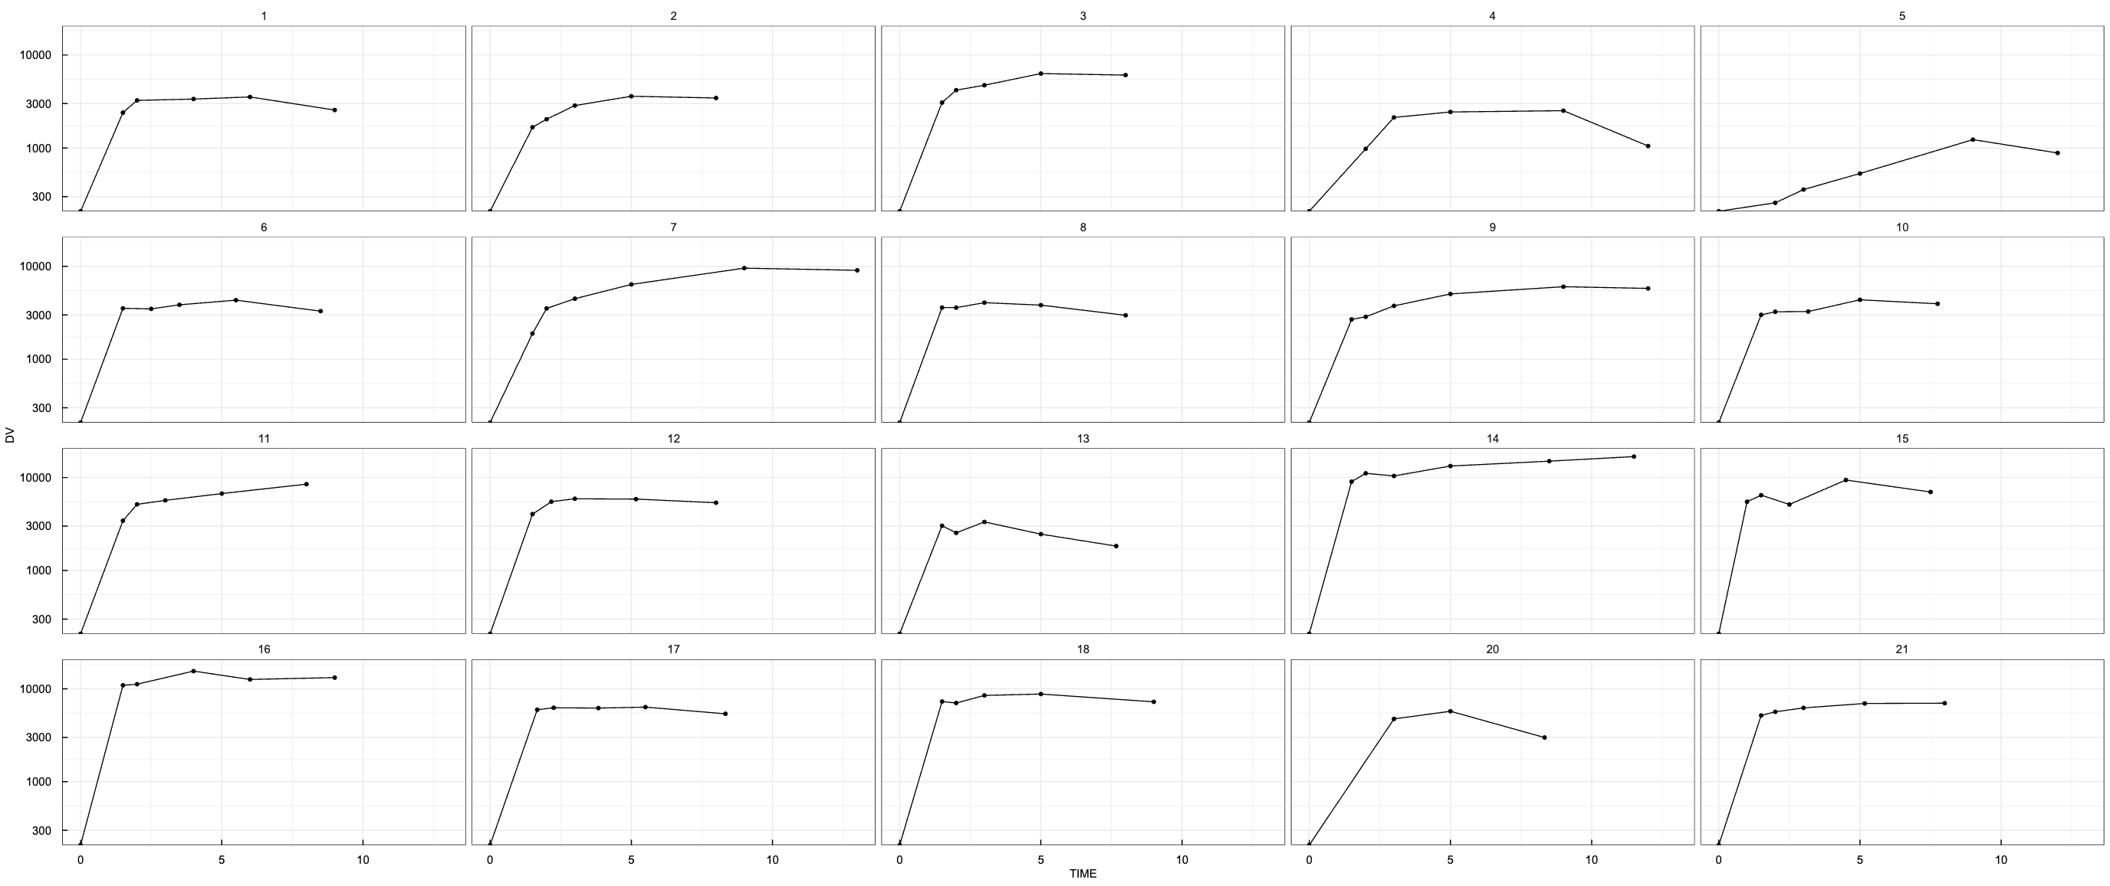
Data exploration (Colistin A)
Single dose (log10)

Slide 11
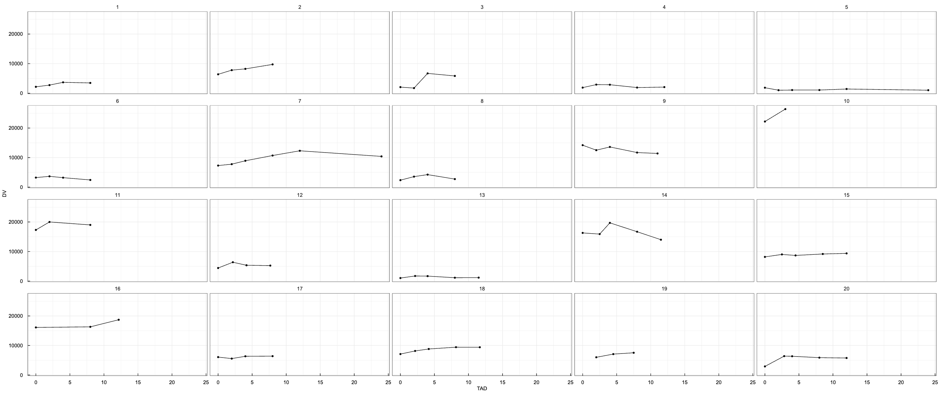
Data exploration (Colistin A)
Multiple dose

Slide 12
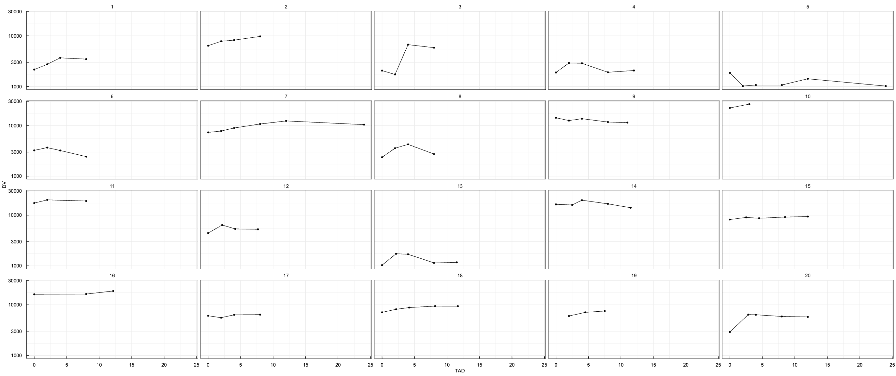
Data exploration (Colistin A)
Multiple dose (log10)

Slide 13
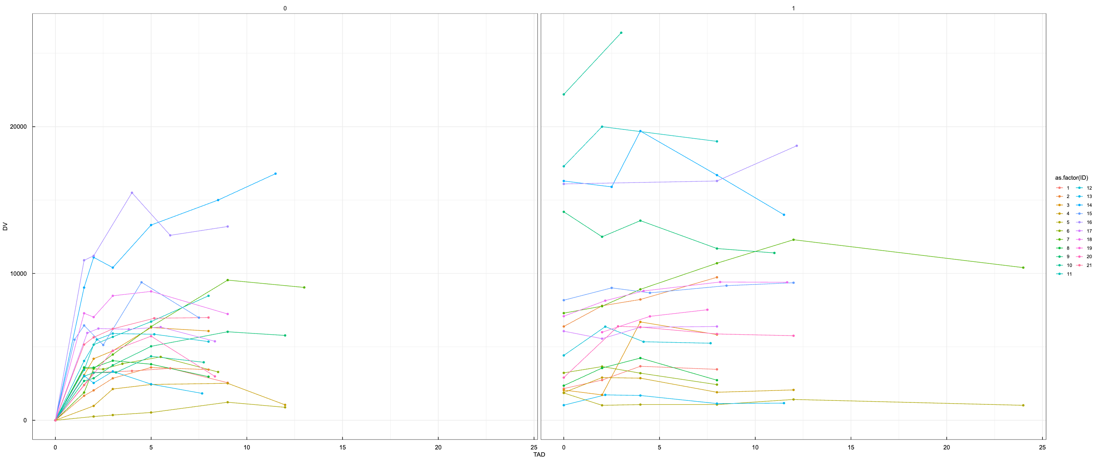
Data exploration (Colistin A)

Slide 14
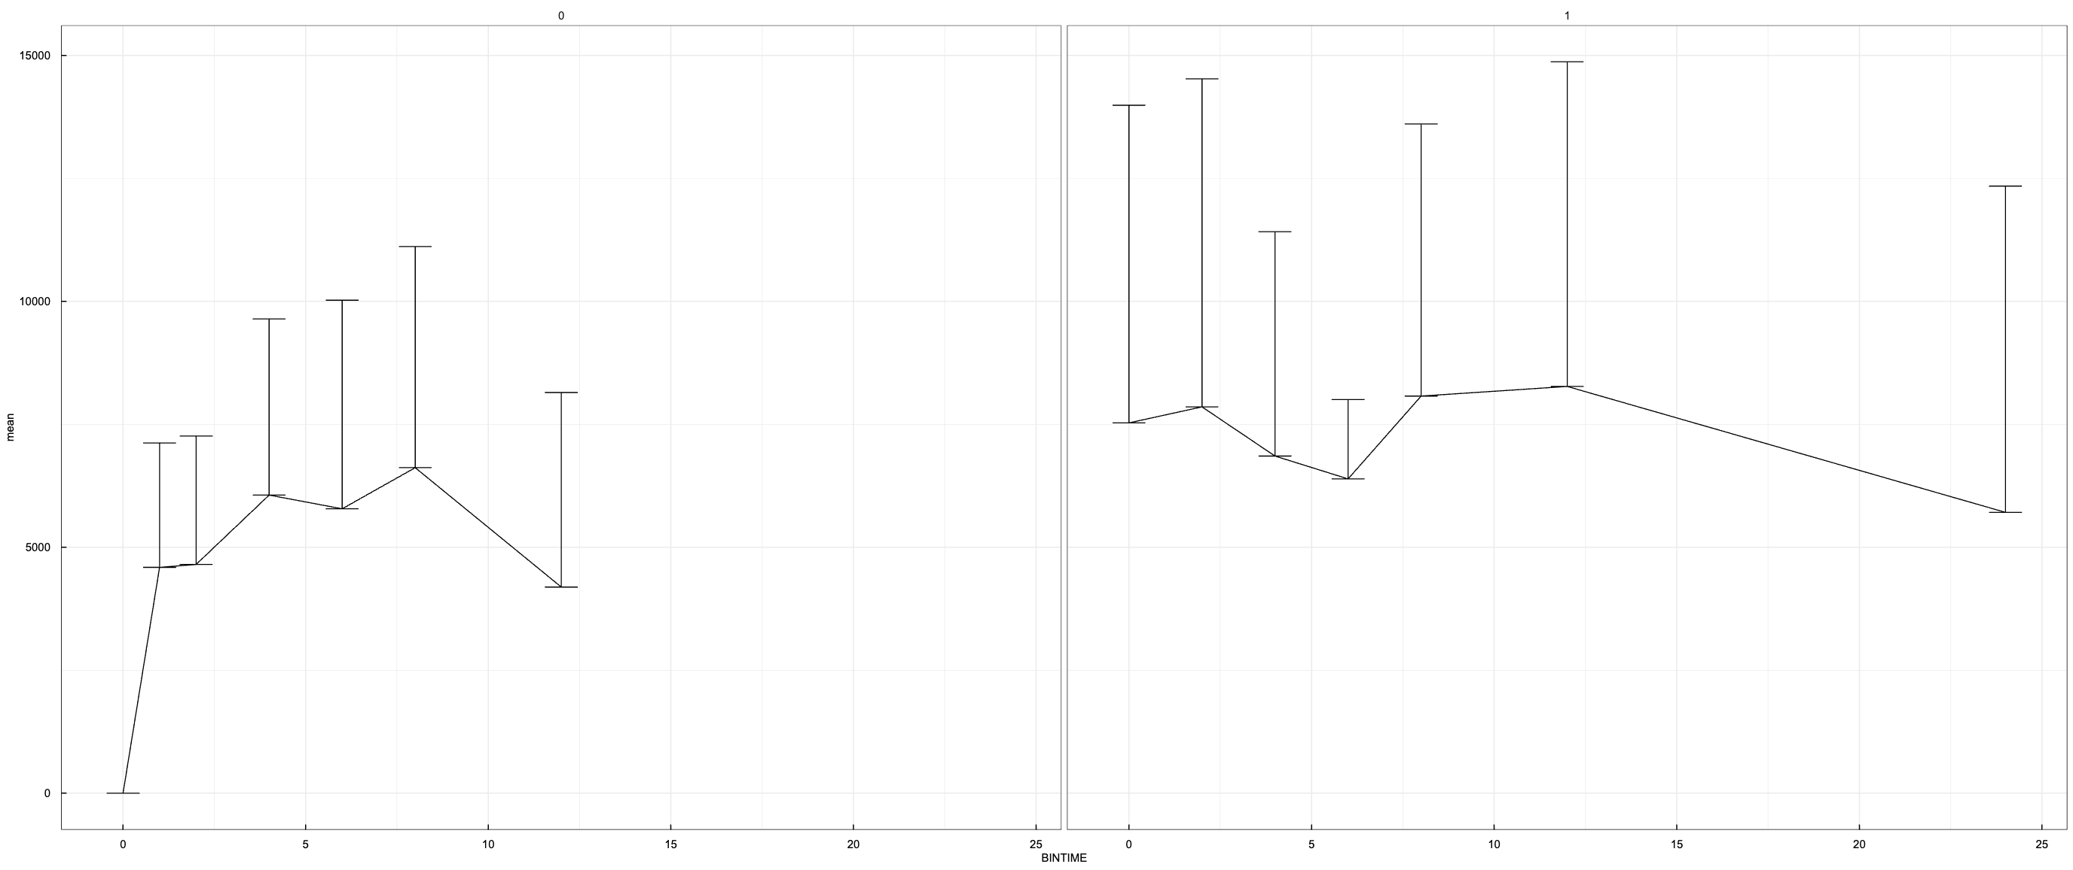
Data exploration (Colistin A)

Slide 15
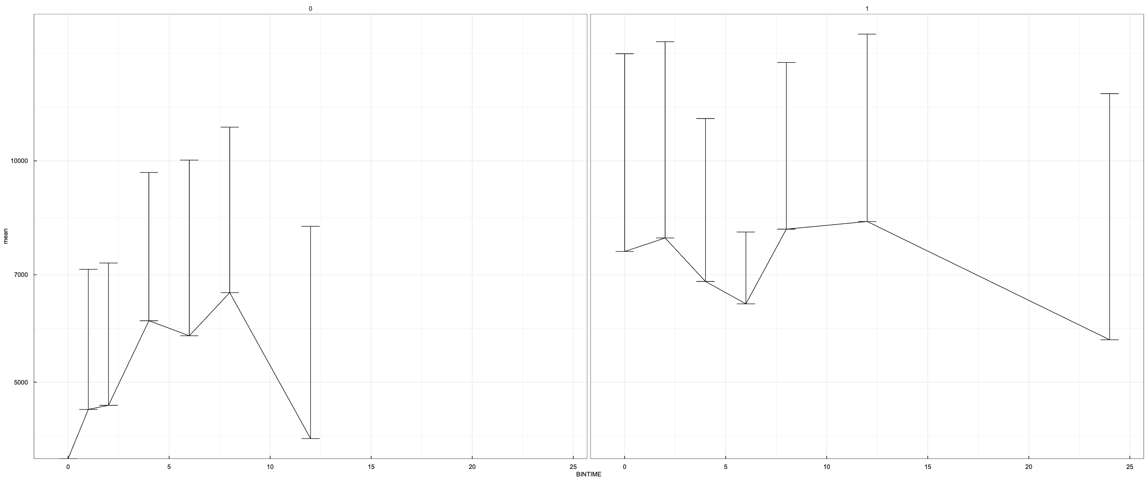
Data exploration (Colistin A)

Slide 16
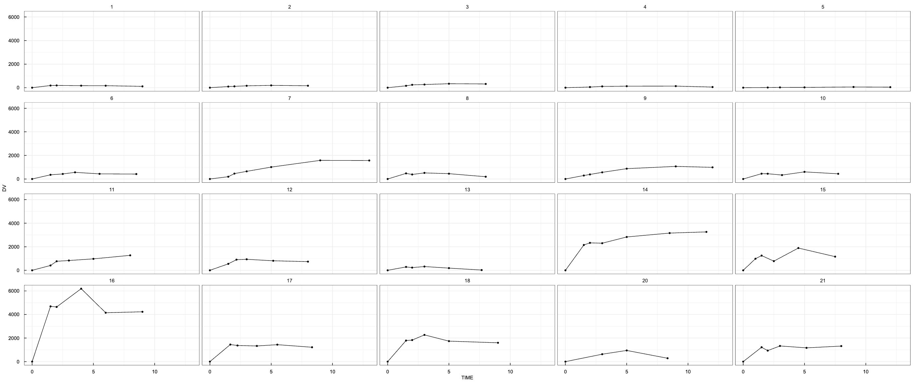
Data exploration (Colistin B)
Single dose

Slide 17
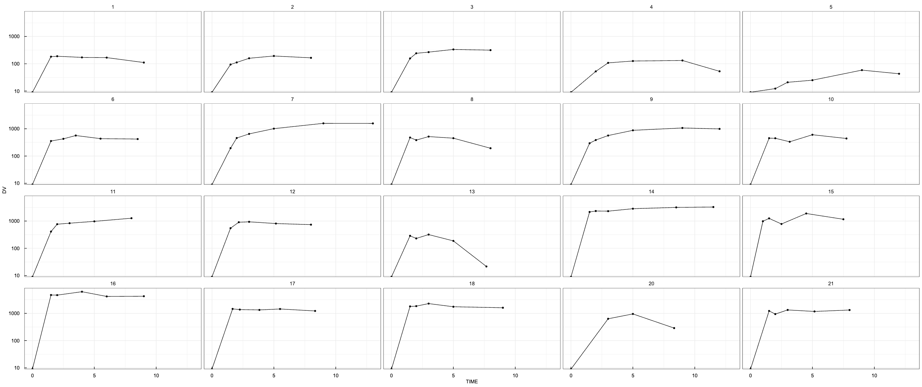
Data exploration (Colistin B)
Single dose (log10)

Slide 18
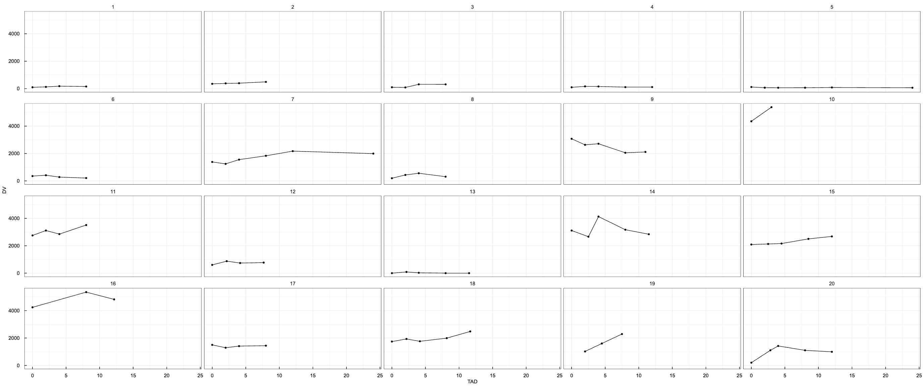
Data exploration (Colistin B)
Multiple dose

Slide 19
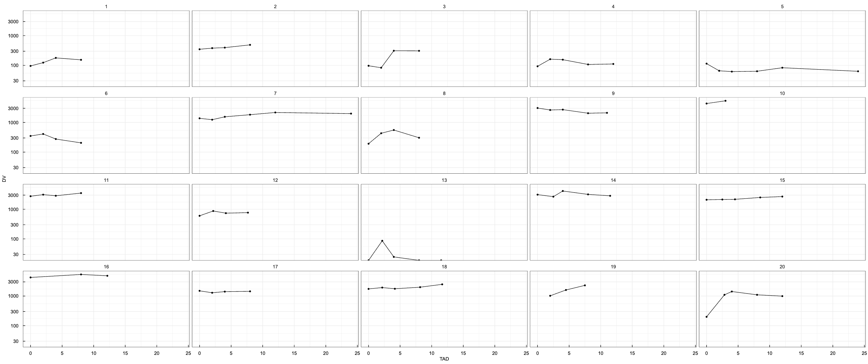
Data exploration (Colistin B)
Multiple dose (log10)

Slide 20
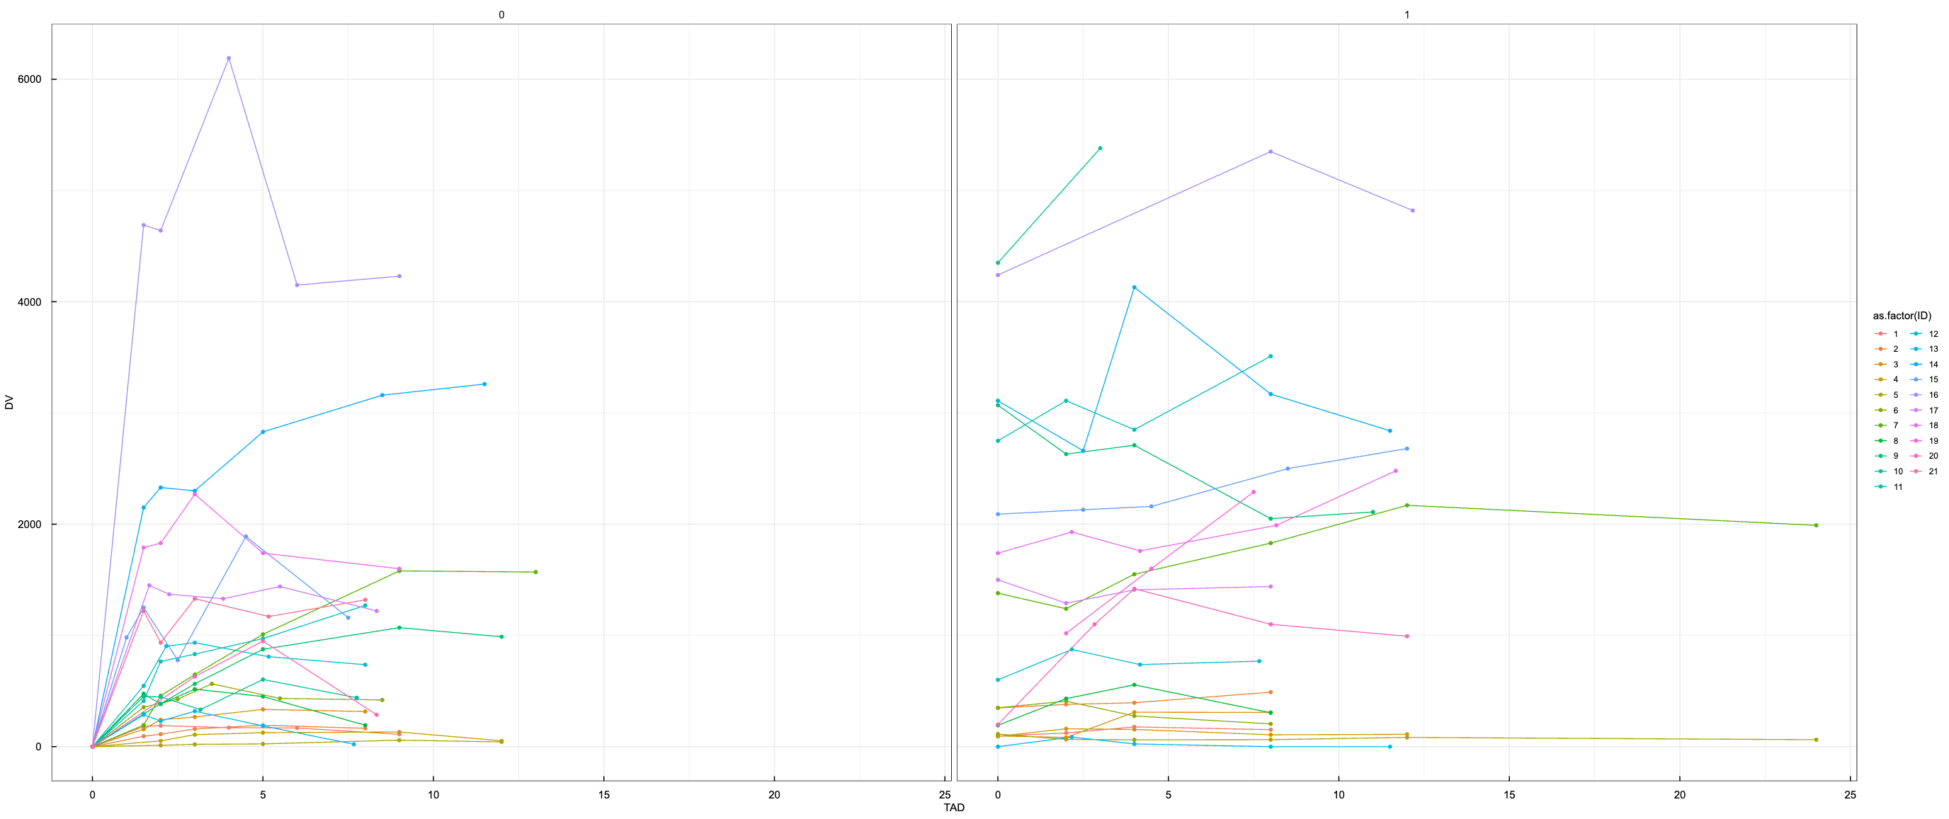
Data exploration (Colistin B)

Slide 21
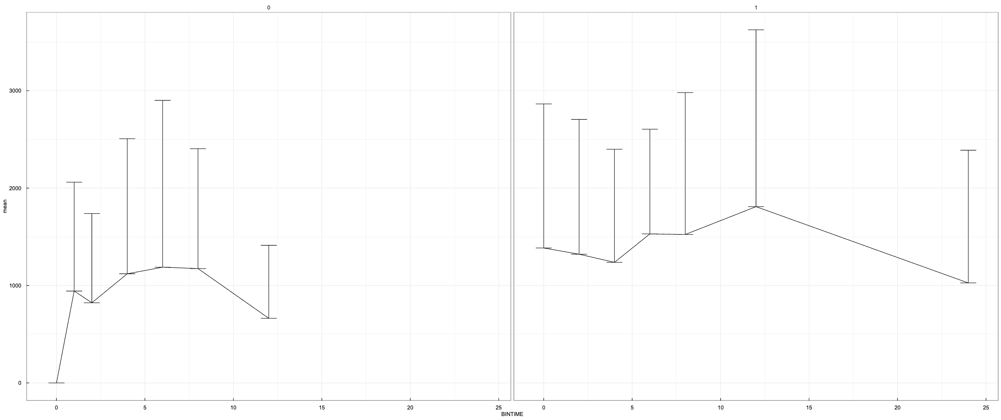
Data exploration (Colistin B)

Slide 22
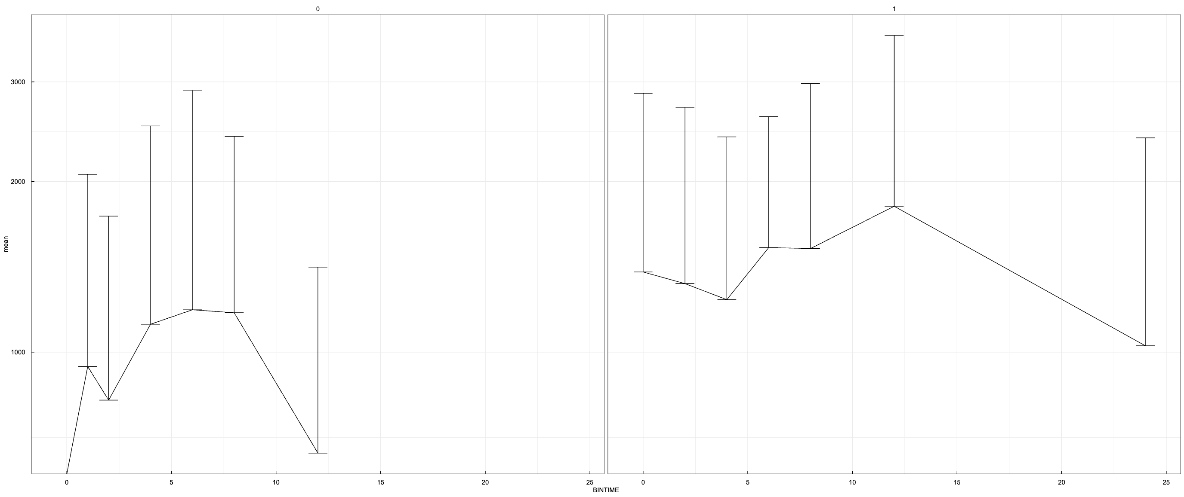
Data exploration (Colistin B)

